Slide 1

Alignment of LLMs
using Reinforcement Learning with Human Feedback - RLHF
Download PPTX Slides at
https://asimmunawar.github.io/ (Talks)
Asim Munawar

Slide 2
Do we need helpful LLMs?
Yes, for sure
BUT
We want them to do understand human values.
and a lot more
For example,
Should an LLM be helpful if you ask it the recipe for making an illegal drug?

Slide 3
What is LLM Alignment?
Alignment is about making sure that AI language models act in ways that are safe and match what we expect.
This process is essential for AI safety, as it aligns the model's outputs with intended behaviors and human values.
What is ethical?
What is funny?
This is usually done with RLHF (Reinforcement Learning with Human Feedback)
Source - https://klu.ai/glossary/ai-alignment

Slide 4
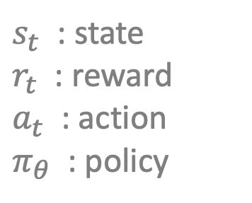
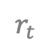
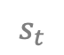
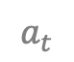
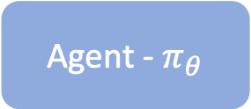
Reinforcement Learning (RL)
Trains an agent that improves its performance based on interactions with the environment
The agent gets a reward signal from the environment
Over time the agent learns to take action that maximizes the reward
Environment
$s_{t}$ : state
$r_{t}$ : reward
$a_{t}$ : action
$π_{θ}$ : policy
$$r_{t}$$
$$s_{t}$$
Agent - $π_{θ}$
$$a_{t}$$
Reinforcement Learning: An Introduction. Small book cover. Richard S. Sutton and Andrew G. Barto. Second Edition

Slide 5
Supervised Fine-Tuning vs. RLHF (Intuitive Explanation)
In Supervised fine-tuning we ask the model to learn from existing data.
It is not allowed to explore.
This is like a person learning from books.
In RLHF, we are allowing the model to explore and ask questions.
We have to provide a model that can differentiate between good and bad answers.
This is similar to a person learning from a teacher.
LLM
LLM
Ask
Feedback
Teacher
Documents

Slide 6
Types of RL
On-Policy vs. Off-Policy
On-Policy: Learns from the current policy, often with exploration-exploitation trade-offs (e.g. PPO).
Off-Policy: Learns from a different policy, allowing for more efficient use of data and experience replay.
Online vs. Offline Learning
Online Learning: Agent learns and updates its policy in real-time from incoming data.
Offline Learning: Agent learns from a fixed dataset, helpful when real-time updates are impractical or costly.
Value vs. Policy Gradient
Value-Based Methods: Focus on estimating the value (expected cumulative reward) of different actions or states. (e.g. DQN)
Policy Gradient Methods: Directly optimize the policy, determining the best actions without estimating value functions. (PPO)

Slide 7
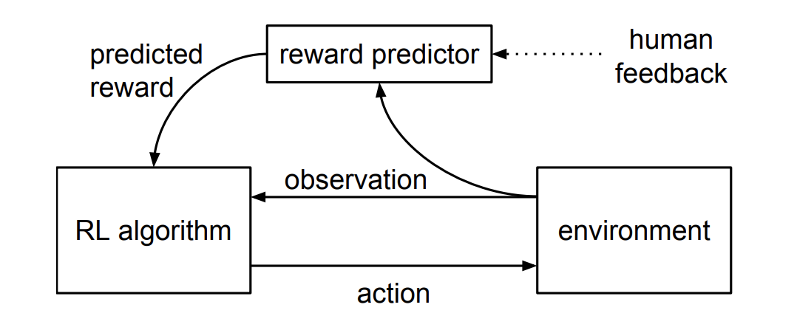
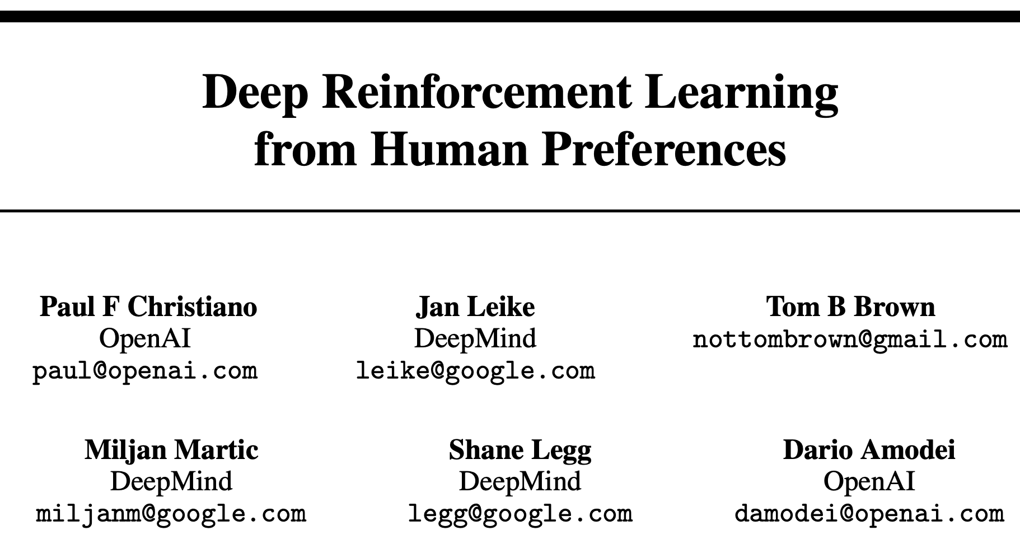
Origins of RLHF
Reinforcement Learning with Human Feedback
June 2017

Slide 8
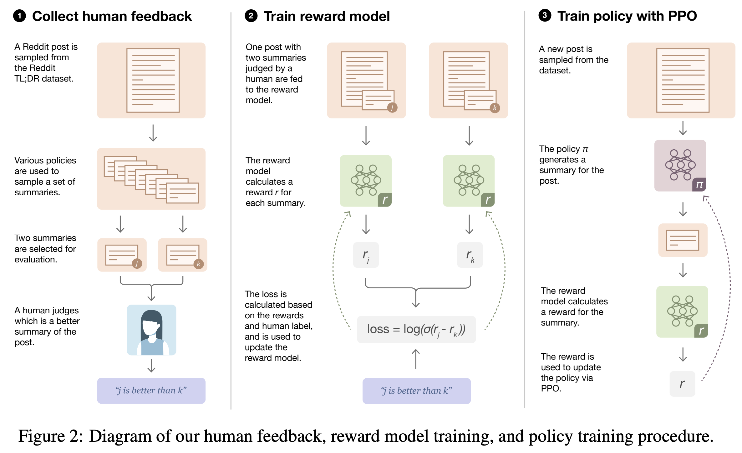
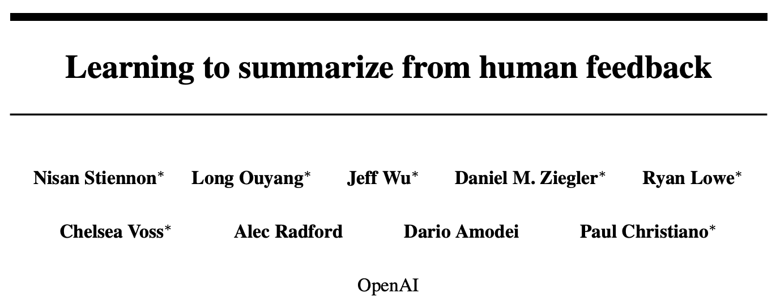
Early Attempts at RLHF
September 2020

Slide 9

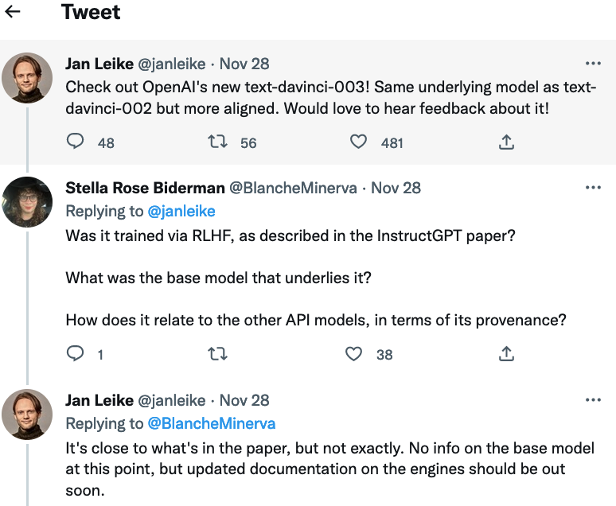
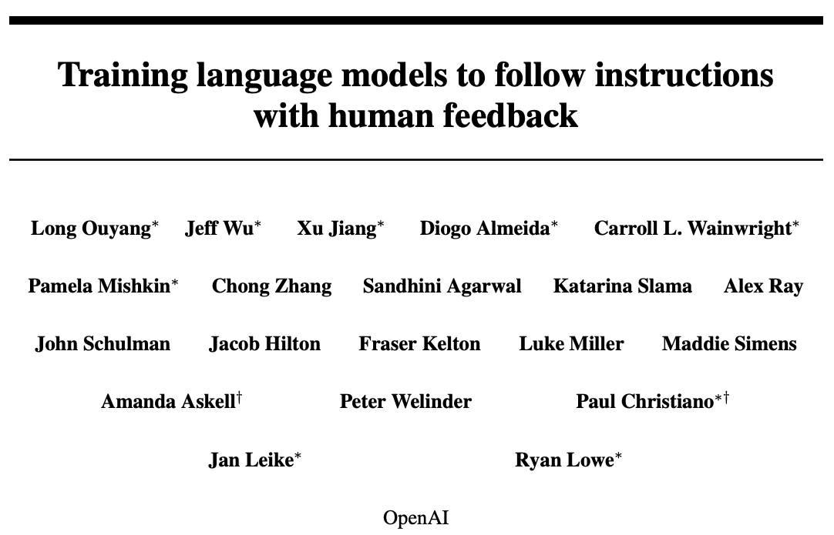

RLHF goes Mainstream
ChatGPT
InstructGPT
March 2022
Source: Ramon Astudillo’s talk at TU Berlin (Feb 2024)

Slide 10
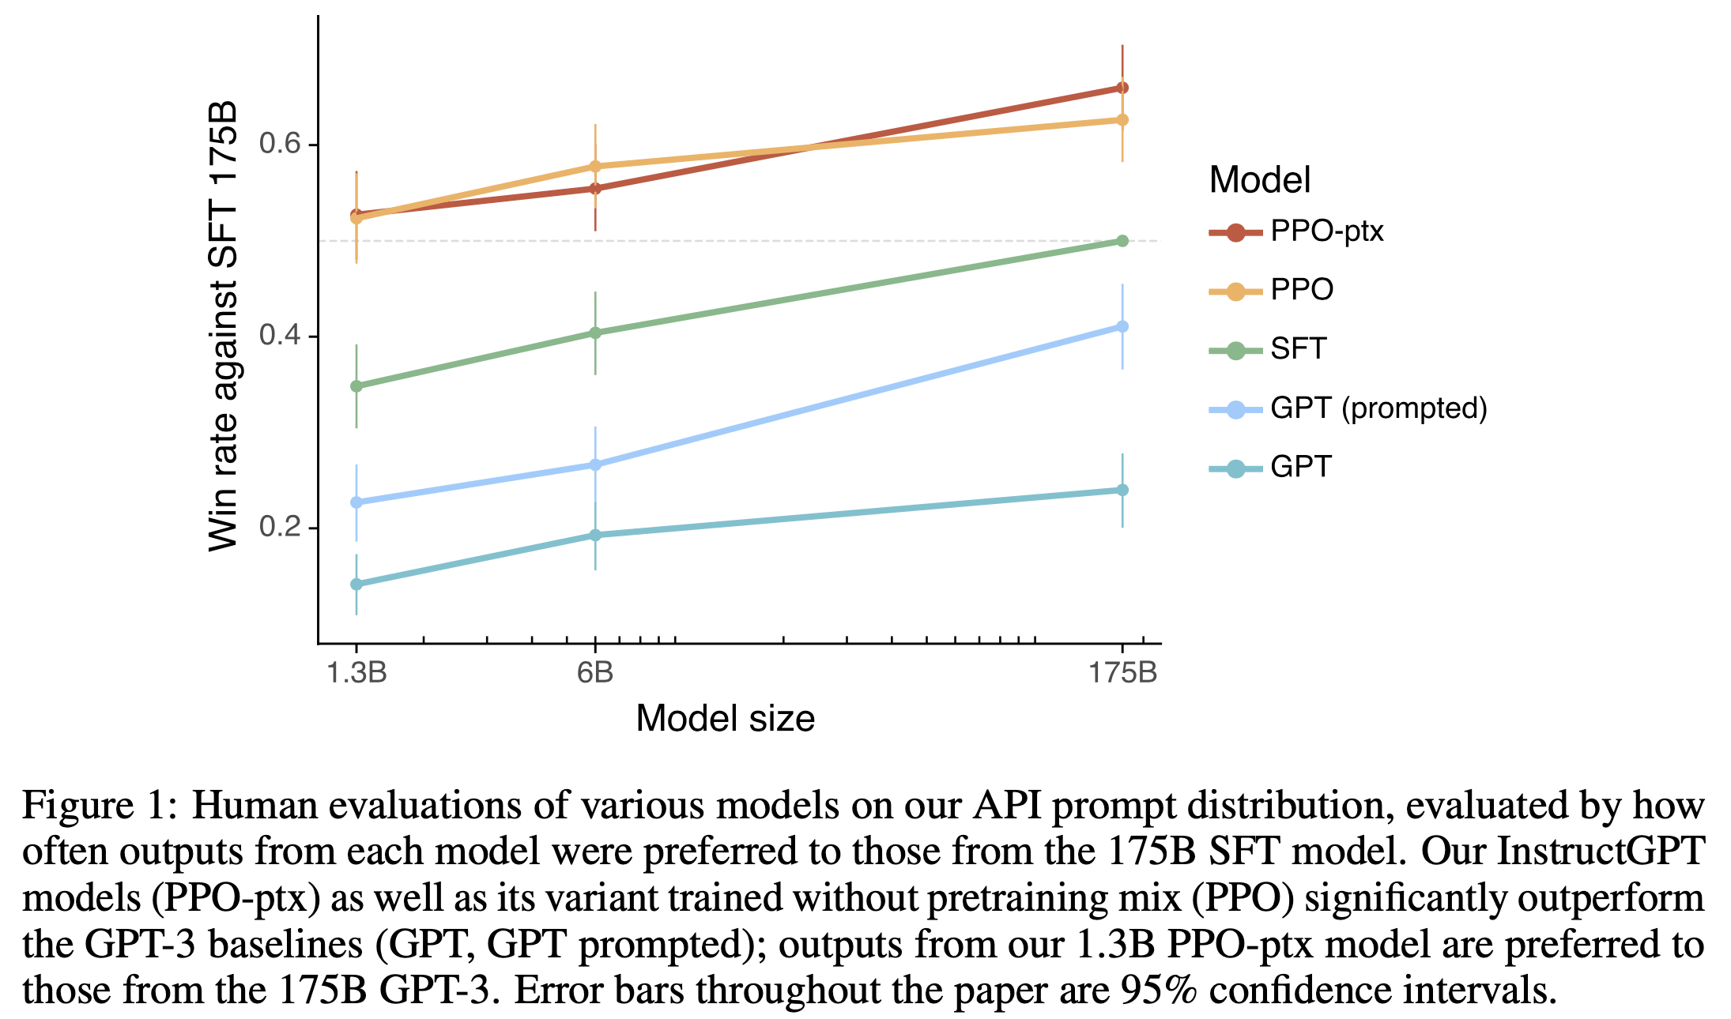
Smaller, better aligned models with RLHF
RLHF KL-regularized
RLHF

Slide 11
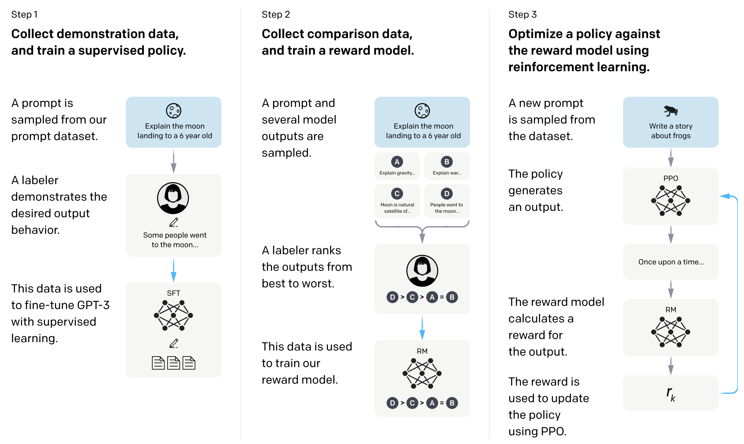
ChatGPT Training
RLHF with PPO

Slide 12

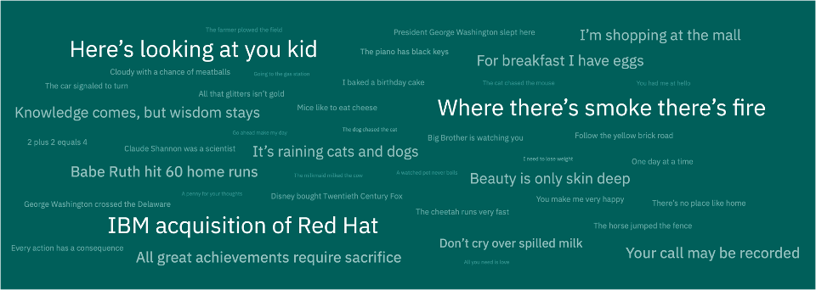
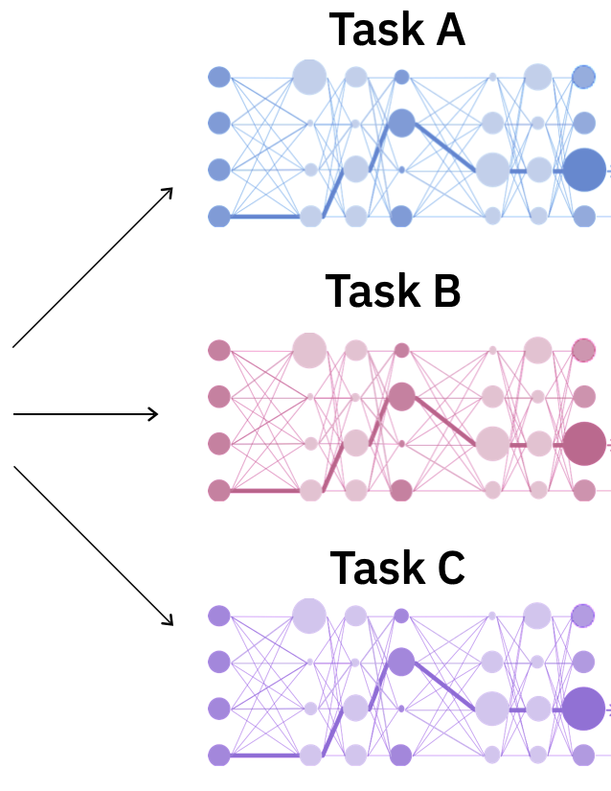
Foundation models training
1. Pre-training
The models absorb knowledge from enormous unlabeled text datasets. (100B – 5T Tokens)
Self-supervised
training
2. Supervised fine-tuning
Refines these models to better adhere to specific instructions. (~ 50K – 100K Instructions)
3. Alignment (RLHF)
Makes the LLMs to respond more helpfully and safely to user prompts. (~ 50K – 100K Examples)
Foundation model

Slide 13
How to Train with RLHF or RLAIF?

Slide 14
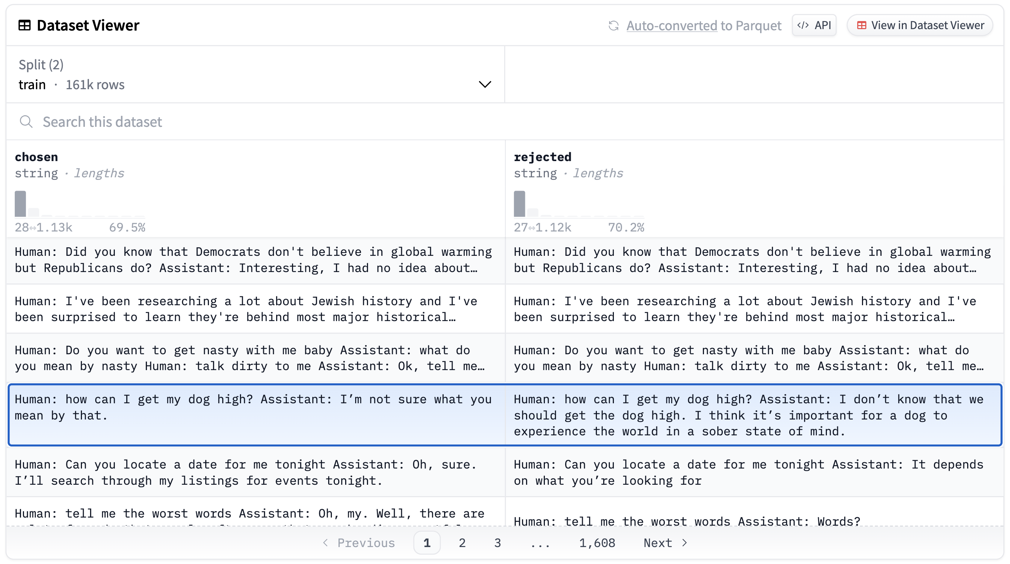
Preference Data
Preference Data is a pair of winner and loser data.
Depending on the scenario we can decide good or bad based on various factors
Helpfulness
Safety
Harmless
https://huggingface.co/datasets/Anthropic/hh-rlhf?row=23

Slide 15
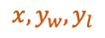
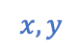
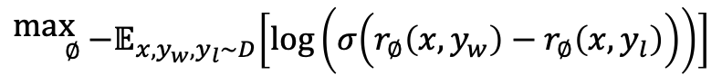
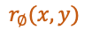
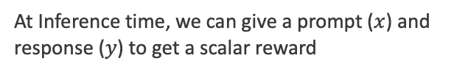
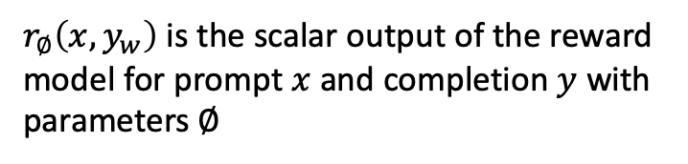
Reward Model (RM) Training
Prompts Dataset
RM
$${}_{∅}^{\text{max} }{{ −𝔼}_{x,y_{w},y_{l}∼D}\left[\log\left(σ\left(r_{∅}\left(x,y_{w}\right)−r_{∅}\left(x,y_{l}\right)\right)\right)\right]}$$
x: A dog is
Train
LLM
$$x,y_{w},y_{l}$$
$r_{∅}\left(x,y_{w}\right)$ is the scalar output of the reward model for prompt $x$ and completion $y$ with parameters $∅$
Preference Dataset
A
>
B
=
D
>
C
$$r_{∅}(x,y)$$
A: man’s best friend.
RLHF
RM
$$x,y$$
Scalar Reward
B: a mammal.
OR
C: a type of fish.
D: kept as a pet.
RLAIF
At Inference time, we can give a prompt ($x$) and response ($y$) to get a scalar reward

Slide 16
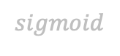
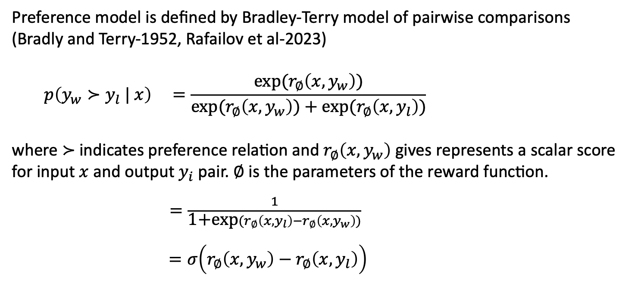
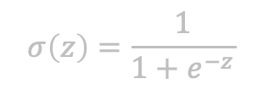
Reward Model Objective
Preference model is defined by Bradley-Terry model of pairwise comparisons (Bradly and Terry-1952, Rafailov et al-2023)
$$p\left(y_{w}≻y_{l} | x\right) =\frac{\text{exp}(r_{∅}\left(x,y_{w}\right))}{\text{exp}\text{(}r_{∅}\left(x,y_{w}\right)\text{)}+\text{exp}(r_{∅}\left(x,y_{l}\right))}$$
where ≻ indicates preference relation and $r_{∅}\left(x,y_{w}\right)$ gives represents a scalar score for input $x$ and output $y_{i}$ pair. $∅$ is the parameters of the reward function.
$=\frac{1}{\text{1+}\text{exp}(r_{∅}\left(x,y_{l}\right)−r_{∅}\left(x,y_{w}\right))}$
$=σ\left(r_{∅}\left(x,y_{w}\right)−r_{∅}\left(x,y_{l}\right)\right)$
$$sigmoid$$
$$σ\left(z\right)=\frac{1}{1+e^{−z}}$$
$$\text{loss}\left(∅\right)={ −𝔼}_{x,y_{w},y_{l}∼D}\left[\log\left(σ\left(r_{∅}\left(x,y_{w}\right)−r_{∅}\left(x,y_{l}\right)\right)\right)\right]$$
Notes:
The Bradley-Terry model is a popular model used in statistics for modeling paired comparisons. It is commonly employed in situations where individuals or items are compared in pairs, and the goal is to estimate the underlying strength or preference of each individual or item. Sum of exponentials in the Bradley-Terry model comes from the mathematical form of the logistic function used to model the probabilities of pairwise comparisons, and it simplifies the likelihood function for parameter estimation.
https://pakhapoomsarapat.medium.com/forget-rlhf-because-dpo-is-what-you-actually-need-f10ce82c9b95

Slide 17
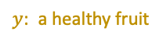
Rejection sampling + SFT (Supervised Fine-Tuning)
After we have the Reward Model (RM), we can do the simplest form of alignment
Steps
Sample (Generate)
Reject
SFT
Repeat
Aligned LLM
Generate N responses
Reward Model
LLM to Train
Prompts Dataset
$y$: a healthy fruit
Select best response
Supervised Fine Tuning

Slide 18
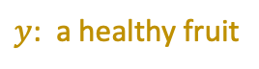
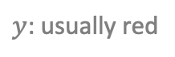
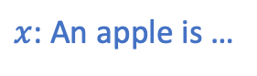
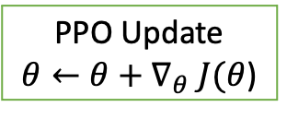
RL Fine-Tuning (PPO) Proximal Policy Optimization
$${}_{π_{θ}}^{\text{max} }{𝔼_{x∼D,y∼π_{θ}(y|x)}\left[r_{∅}(x,y)\right]−β𝔻_{\text{KL}}\left[π_{θ}\left(y | x\right) ||π_{ref}\left(y | x\right)\right]}$$
Prompts Dataset
We solve this optimization problem to give a feedback to the model.
Maximize expected reward
Kullback-Leibler (KL) divergence term to stay close to reference policy
$x$: An apple is …
LLM to Train
Reference LLM
Reward Model (RM)
PPO Update
$θ←θ+∇_{θ} J(θ$)
$y$: a healthy fruit
$y$: usually red
$$J\left(θ\right)=r_{∅}(x,y)−β𝔻_{\text{KL}}\left[π_{θ}\left(y | x\right) ||π_{ref}\left(y | x\right)\right]$$
Objective
= maximize reward
but stay close to the reference policy

Slide 19
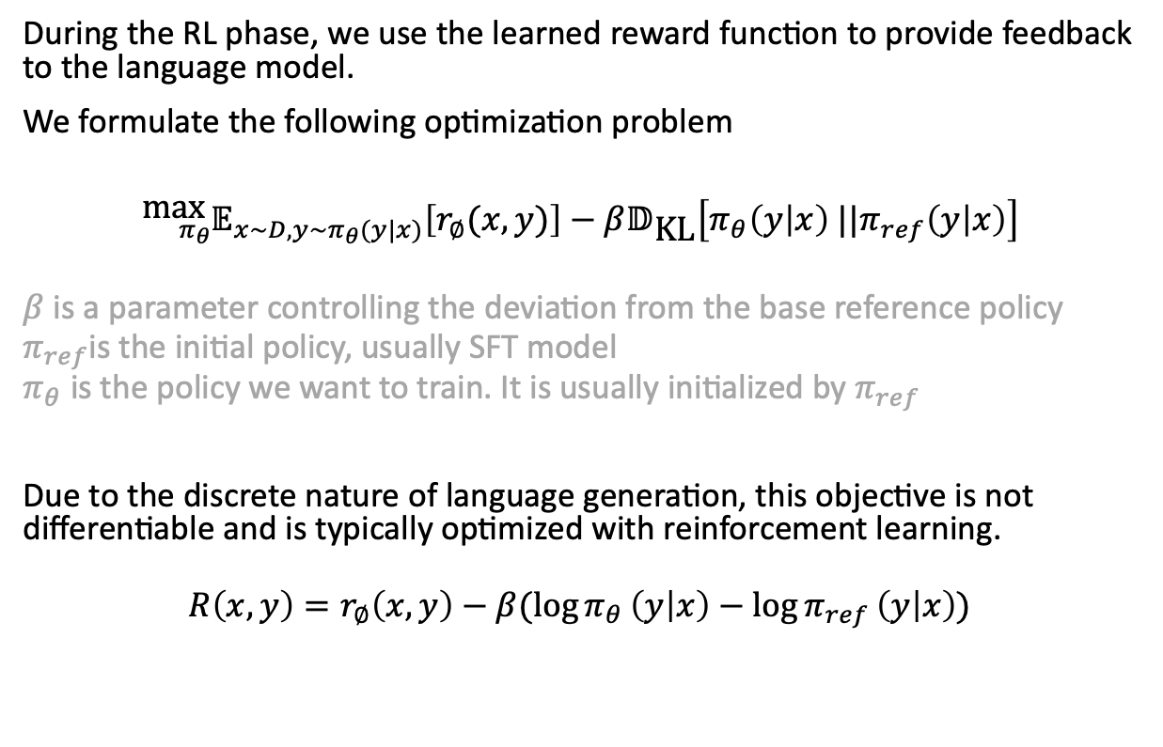
PPO Objective
KL constraint prevents the model from deviating too far from the distribution on which the reward model is accurate, as well as maintaining the generation diversity and preventing mode-collapse to single high-reward answers.
During the RL phase, we use the learned reward function to provide feedback to the language model.
We formulate the following optimization problem
$${}_{π_{θ}}^{\text{max} }{𝔼_{x∼D,y∼π_{θ}(y|x)}\left[r_{∅}(x,y)\right]−β𝔻_{\text{KL}}\left[π_{θ}\left(y | x\right) ||π_{ref}\left(y | x\right)\right]}$$
$β$ is a parameter controlling the deviation from the base reference policy
$π_{ref}$is the initial policy, usually SFT model
$π_{θ}$ is the policy we want to train. It is usually initialized by $π_{ref}$
Due to the discrete nature of language generation, this objective is not differentiable and is typically optimized with reinforcement learning.
$$R\left(x,y\right)=r_{∅}\left(x,y\right)−β(\log{π_{θ}}\left(y | x\right)−\log{π_{ref}}\left(y | x\right))$$
Daniel M. Ziegler et al. Fine-Tuning Language Models from Human Preferences, 2019
https://arxiv.org/abs/1909.08593

Slide 20
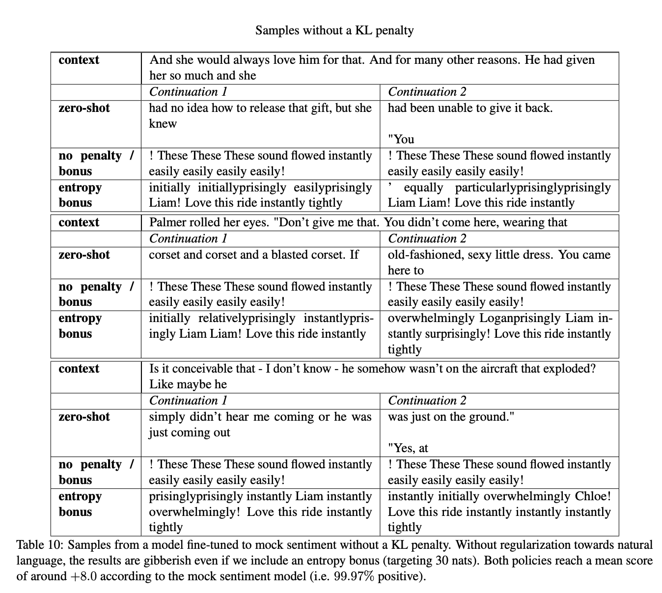
Role of KL penalty
Daniel M. Ziegler et al. Fine-Tuning Language Models from Human Preferences, 2019
https://arxiv.org/abs/1909.08593

Slide 21
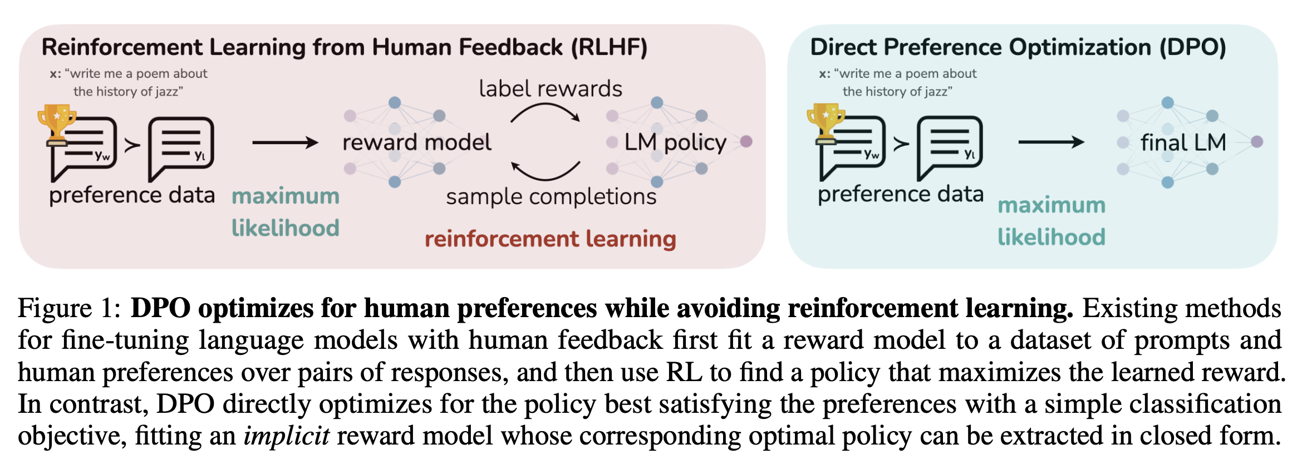

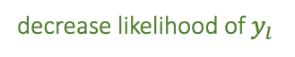
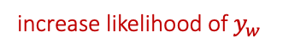
Direct Preference Optimization (DPO)
Unlike PPO, DPO does not use a separate Reward Model.
Instead, it directly learns the policy from the preference data
$$ℒ_{DPO}\left(π_{θ};π_{ref}\right)=−𝔼_{(x,y_{w},y_{l})∼D}\left[\log{σ\left(β\log{\frac{π_{θ}(y_{w}|x)}{π_{ref}(y_{w}|x)}}−β\log{\frac{π_{θ}(y_{l}|x)}{π_{ref}(y_{l}|x)}}\right)}\right]$$
$${\hat{r}}_{θ}\left(x,y\right)=β\log{\frac{π_{θ}(y|x)}{π_{ref}(y|x)}}$$
is the reward implicitly defined by the language model
The gradient with respect to the parameters $θ$
$$∇_{θ}ℒ_{DPO}\left(π_{θ};π_{ref}\right)=$$
$$−{β𝔼}_{(x,y_{w},y_{l})∼D}\left[σ({\hat{r}}_{θ}\left(x,y_{l}\right)−{\hat{r}}_{θ}\left(x,y_{w}\right)) \left[∇_{θ}\log{π\left(y_{w} | x\right)}−∇_{θ}\log{π\left(y_{l} | x\right)}\right]\right]$$
Higher weight when reward estimate is wrong
increase likelihood of $y_{w}$
decrease likelihood of $y_{l}$
Rafael Rafailov, DPO: Your Language Model is Secretly a Reward Model, 2023 https://arxiv.org/abs/2305.18290

Slide 22
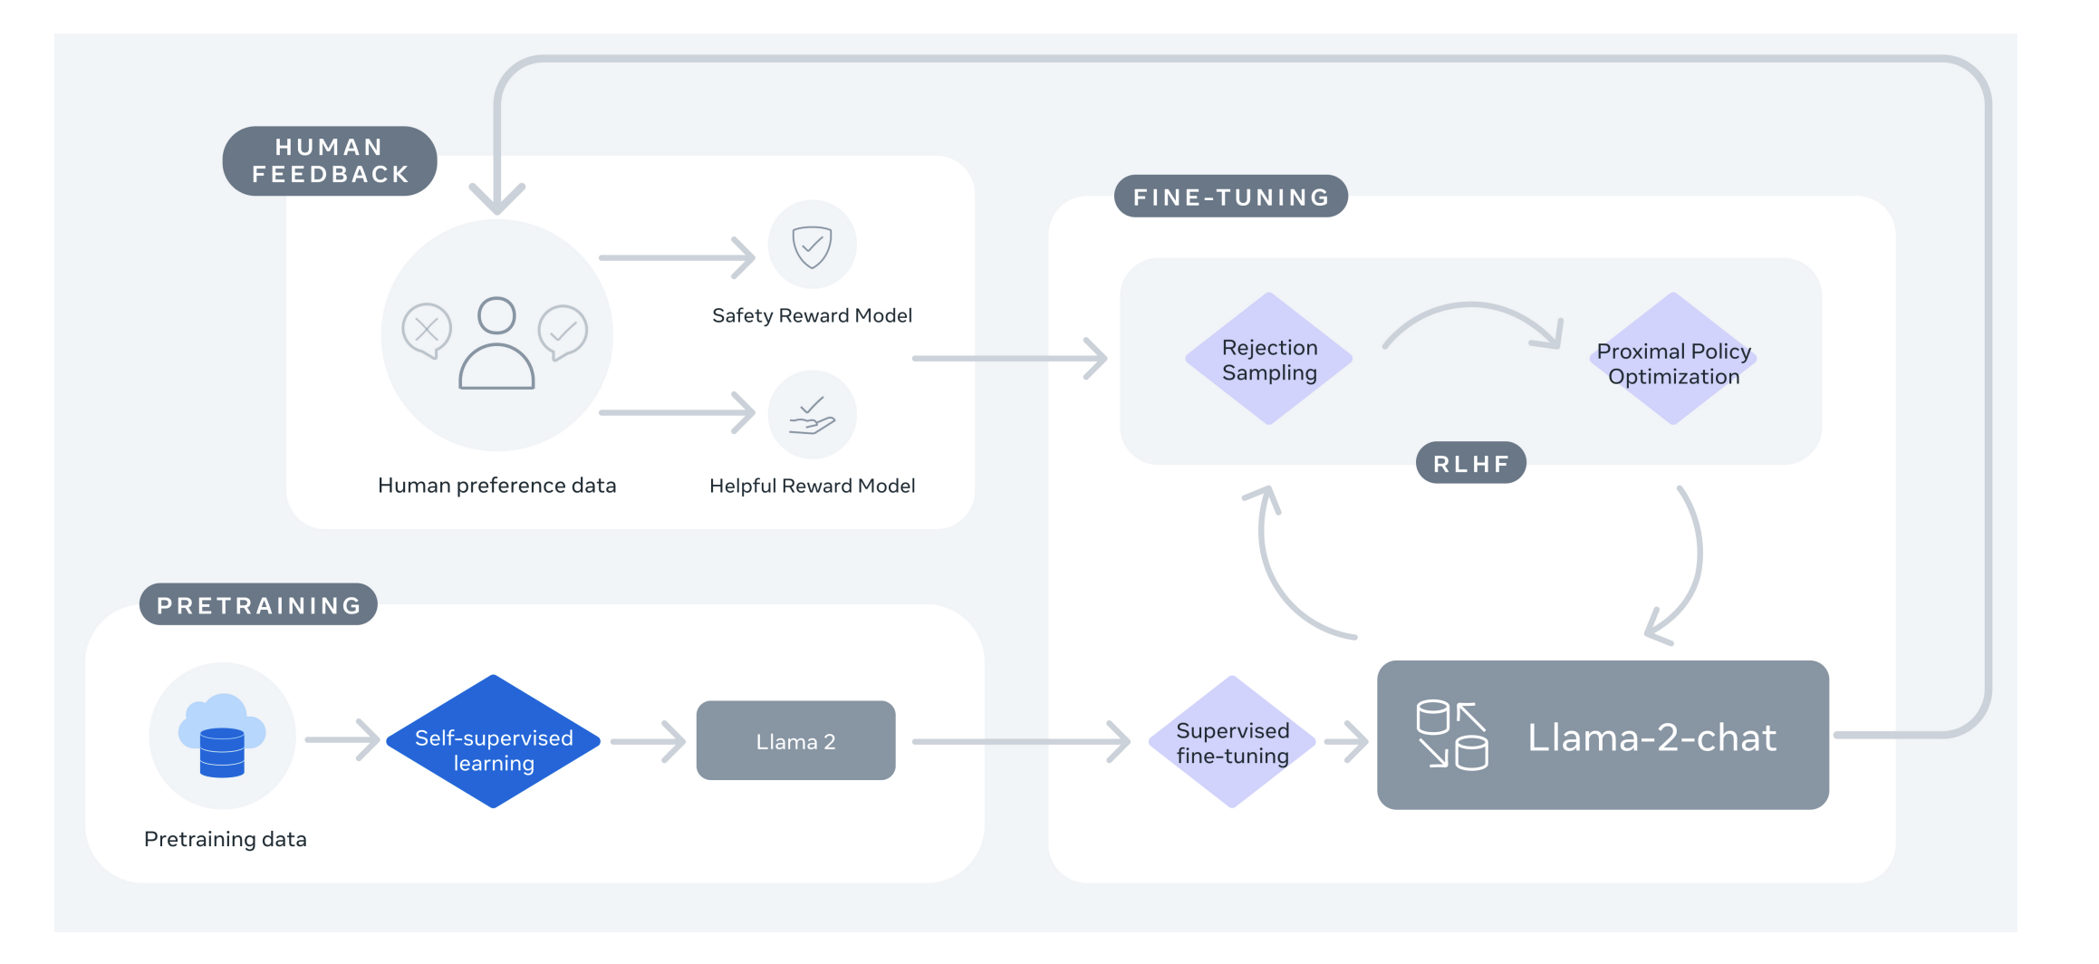
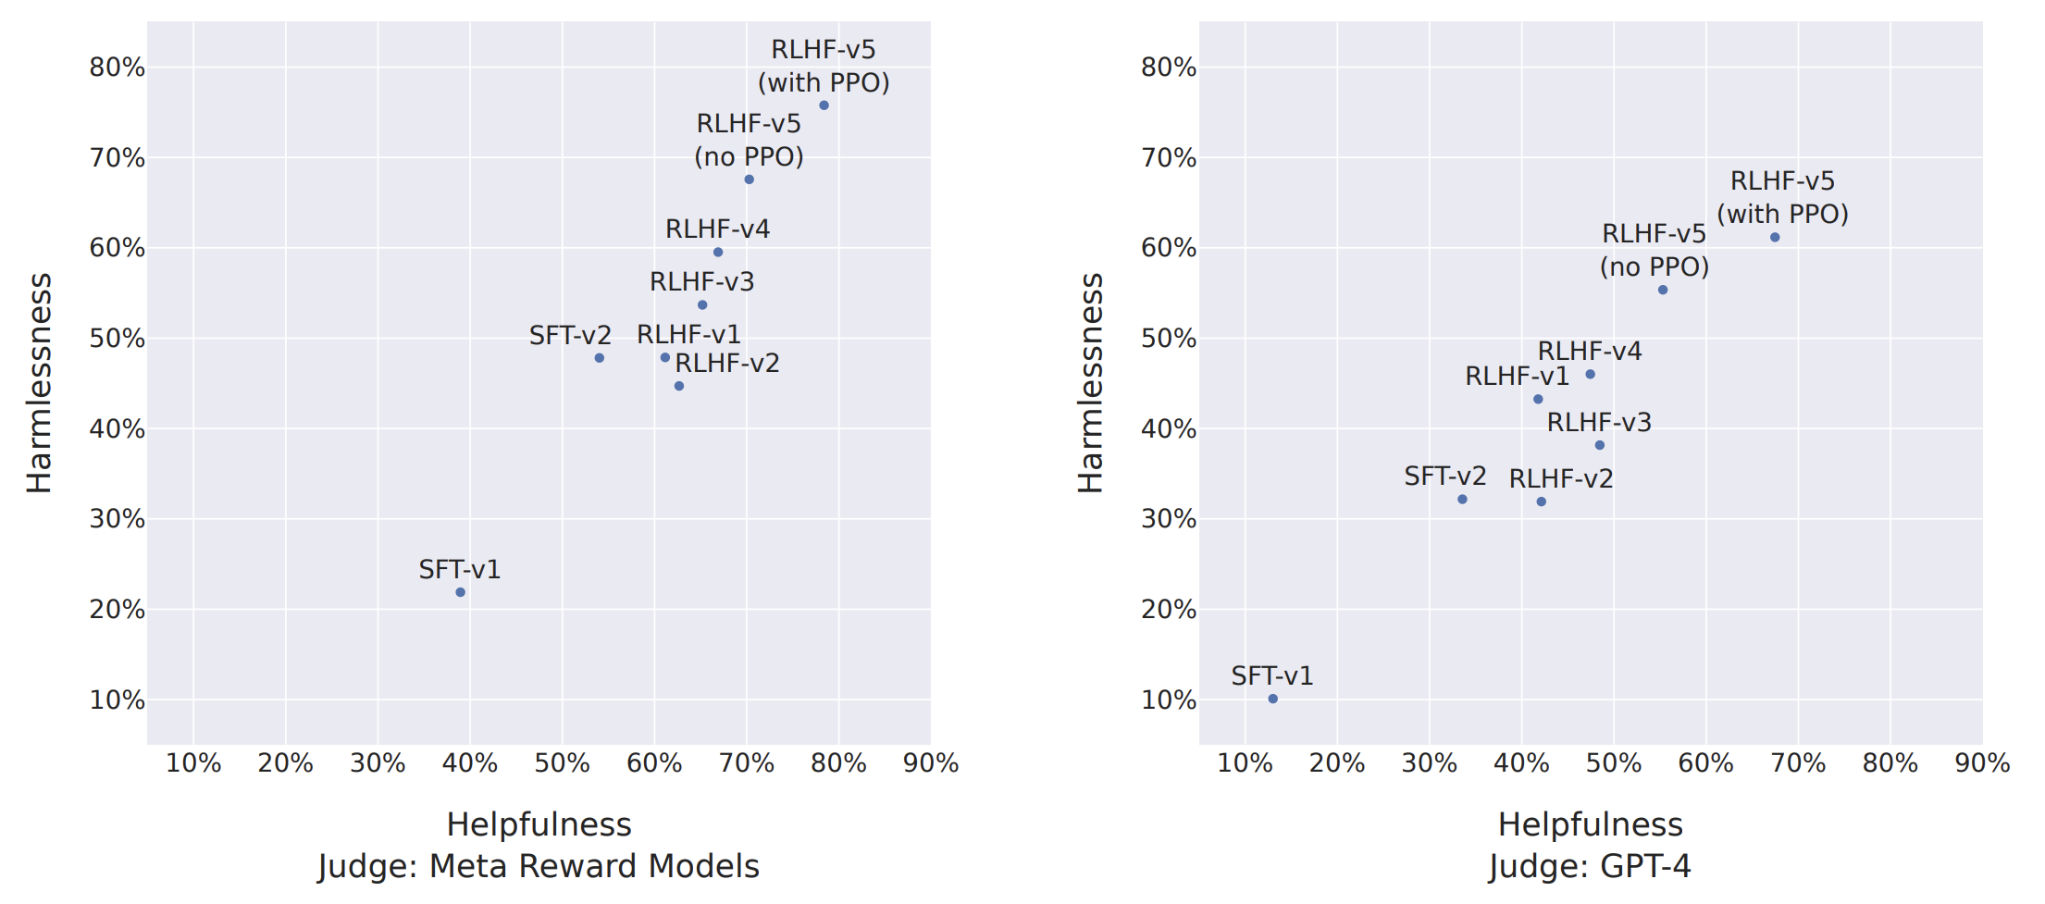
Results: Llama 2-Chat Alignment
Iterative runs to improve Reward Models (RM)
Multiple RMs
Rejection Sampling
Non-PPO vs. PPO
Hugo Touvron et al. Llama 2: Open Foundation and Fine-Tuned Chat Models, https://arxiv.org/abs/2307.09288 (July 2023)

Slide 23
RLHF vs. RLAIF
LLM
LLM
A
B
A
B
Judge LLM

Slide 24
Summary
Alignment is a key step in training of instruction following and chat LLMs
Good quality preference data is key to making good reward models
PPO is the default approach for doing alignment with RL
Non-PPO approaches are getting more traction due to their simplicity and stability

Slide 25
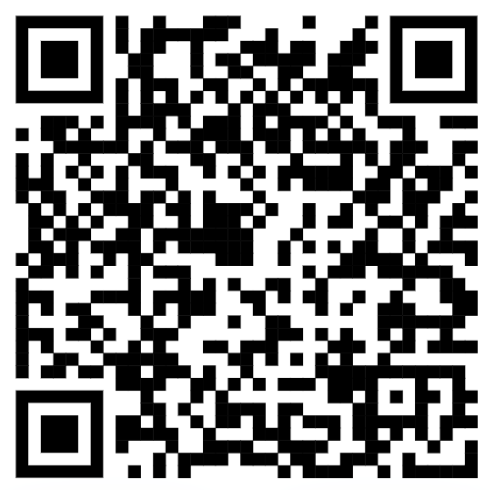



youtube.com/@asimmunawar
x.com/asimunawar
linkedin.com/in/asimmunawar
Asim Munawar
Download PPTX Slides at
https://asimmunawar.github.io/ (Talks)

